Slide 1
Maven
Creating Applications with Maven
Notes:
Page 04-<number>
Maven Creating Applications with Maven

Slide 2
Lesson Objectives
In this lesson, you will learn about:
      Overview
      Testing your application
  Generating Java Projects using Maven in Eclipse Luna
      Setting Maven in Eclipse Environment
      Adding/Updating Dependencies
      Importing Project
      Creating Maven Module
  Creating Web application using Maven
  Creating Maven web Module
Notes:
Explain the lesson coverage
Page 04-<number>
Maven Creating Applications with Maven

Slide 3
4.1.1 Unit tests the code
4.1 Testing your application
The Surefire Plugin is used during the test phase of the build lifecycle to execute the unit tests of an application.
By default, these files are generated at ${basedir}/target/surefire-reports.
The Surefire Plugin has only 1 goal:
  surefire:test runs the unit tests of an application.
By default, the Surefire plugin executes **/Test*.java, **/*Test.java, and **/*TestCase.java test classes
Use the following command to execute the unit tests:
  mvn test
To skip the entire unit test, use “-Dmaven.test.skip=true” option in command line.
For example,
  $ mvn install -Dmaven.test.skip=true
Notes:
It generates reports in 2 different file formats:
Plain text files (*.txt)
XML files (*.xml)
Page 04-<number>
Maven Creating Applications with Maven

Slide 4
4.1.2 Integration testing
4.1 Testing your application
The Failsafe Plugin is used during the integration-test and verify phases of the build lifecycle to execute the integration tests of an application
The Maven lifecycle has four phases for running integration tests:
      pre-integration-test for setting up the integration test environment.
      integration-test for running the integration tests.
      post-integration-test for tearing down the integration test environment.
      verify for checking the results of the integration tests.
Use the following command to run and verify the integration test.
      mvn verify
Notes:
The Failsafe Plugin has only 2 goals:
failsafe:integration-test runs the integration tests of an application.
failsafe:verify verifies that the integration tests of an application passed.
The Failsafe plugin will look for **/IT*.java, **/*IT.java, and **/*ITCase.java.
The Failsafe Plugin is designed to run integration tests while the Surefire Plugins is designed to run unit tests
Page 04-<number>
Maven Creating Applications with Maven

Slide 5
4.1.3 Running unit test in Integration test phase
4.1 Testing your application
Add these code snippet in pom.xml
  …..
  <executions>
  <execution>
  <id>unit-tests</id>
  <phase>test</phase>
  <goals>
  <goal>test</goal>
  </goals>
  <configuration>
  <!-- Never skip running the tests when the test phase is invoked -->
  <skip>false</skip>
  <includes>
  <!-- Include unit tests within integration-test phase. -->
  <include>**/*Tests.java</include>
  </includes>
  <excludes>
  <!-- Exclude integration tests within (unit) test phase. -->
  <exclude>**/*IntegrationTests.java</exclude>
  </excludes>
  </configuration>
  </execution>
  <executions>
  ……
Notes:
Page 04-<number>
Maven Creating Applications with Maven

Slide 6
4.2.1 Starting Eclipse at JDK
4.2 Setting Maven in Eclipse Environment
Maven requires Eclipse using a JDK, instead of a JRE.
To check with what Java version (JRE or JDK) Eclipse is running, do the following:
  Open the menu item "Help > About Eclipse". (On the Mac, it's in the Eclipse-menu, not the Help-menu)
  Click on "Installation Details".
  Switch to the tab "Configuration"
  Search for a line that starts with "-vm". The line following it shows which Java binary is used.
Notes:
Page 05-<number>
Maven Integrating with Eclipse

Slide 7
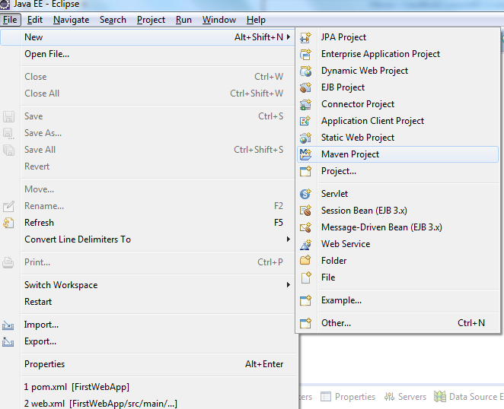
4.3.1 Maven Project in Eclipse
4.3 Creating Maven Project in Eclipse Luna

Slide 8
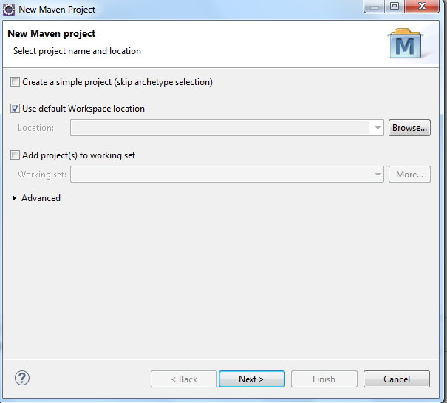
4.3.2 Maven Project in Eclipse
4.3 Creating Maven Project in Eclipse Luna

Slide 9
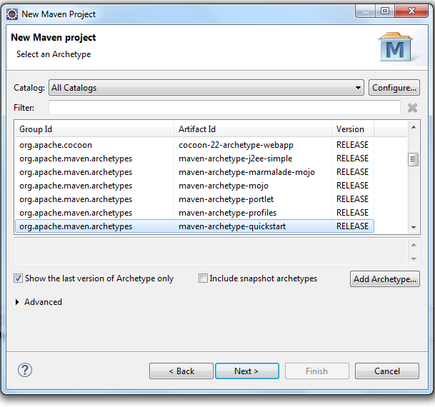
4.3.3 Maven Project in Eclipse
4.3 Creating Maven Project in Eclipse Luna

Slide 10
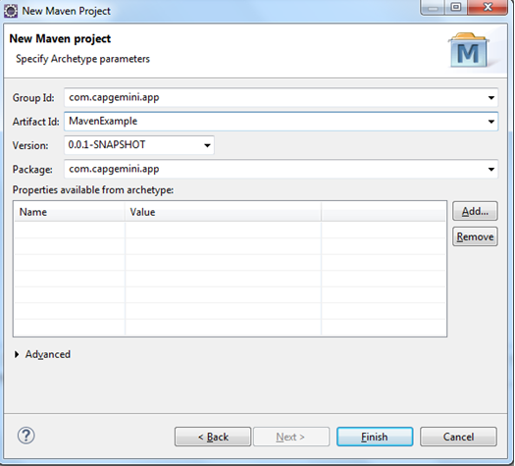
4.3.4 Maven Project in Eclipse
4.3 Creating Maven Project in Eclipse Luna

Slide 11
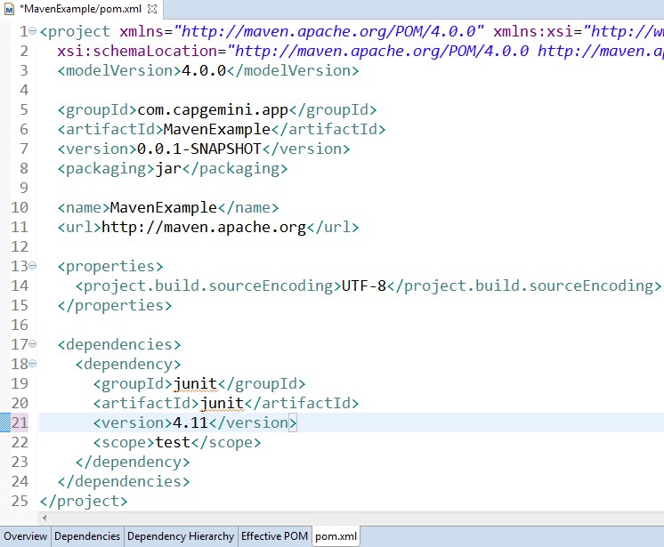
4.3.5 Maven Project in Eclipse
4.3 Creating Maven Project in Eclipse Luna
Update the jUnit version to 4.11 in pom.xml

Slide 12
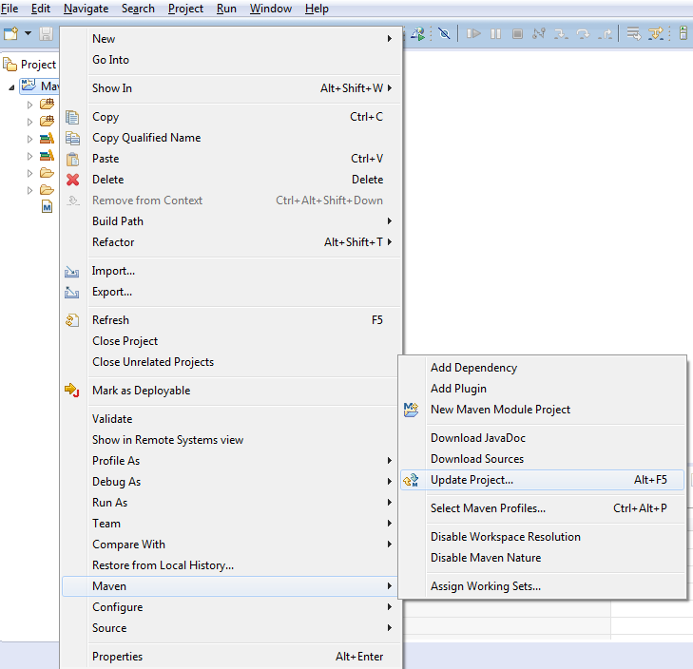
4.3.6 Maven Project in Eclipse
4.3 Creating Maven Project in Eclipse Luna
Update the project as shown:

Slide 13
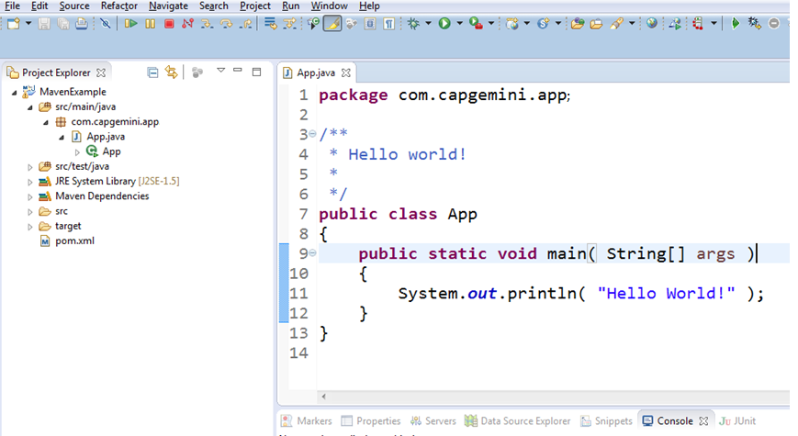
4.3.7 Maven Project in Eclipse
4.3 Creating Maven Project in Eclipse Luna

Slide 14

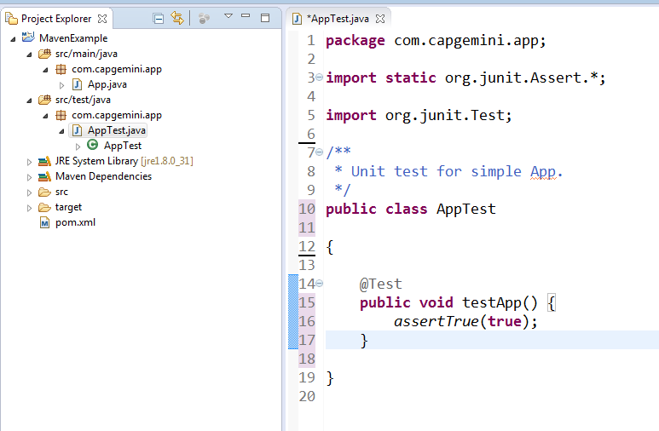
4.3.8 Maven Project in Eclipse
4.3 Creating Maven Project in Eclipse Luna

Slide 15
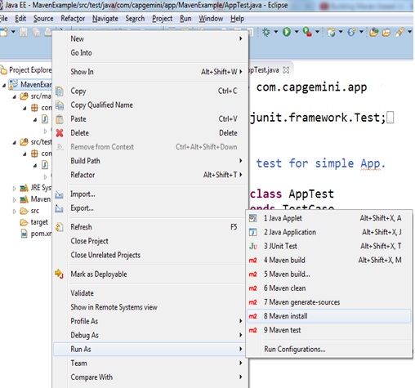
4.3.9 Maven Project in Eclipse
4.3 Creating Maven Project in Eclipse Luna
Use options in Run As Menu to run the common life cycle phases such as clean, install and package…

Slide 16
4.3.10 Adding and Updating Dependencies
4.3 Creating Maven Project in Eclipse Luna
Eclipse offers two options for adding dependencies to a project.
  By manually editing the POM file to type in the XML to add the dependency.
      Open the pom.xml using XML Editor
      Edit the pom by adding /updating dependency and save the file.
  Searching for a dependency using groupId
      Open the pom.xml using Maven POM Editor
      Click on Dependency tab to add the dependency.
      Search the dependency by entering groupId or artifactID.
      Eclipse queries the dependency in repository indexes and even shows a version of the artifact that is currently in local Maven repository

Slide 17
4.3 Creating Maven Projects in Eclipse Luna
Creating and executing the “Maven Example!” program
Notes:
Page 05-<number>
Maven Integrating with Eclipse

Slide 18
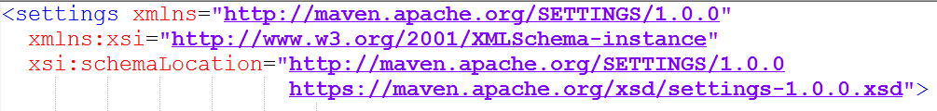
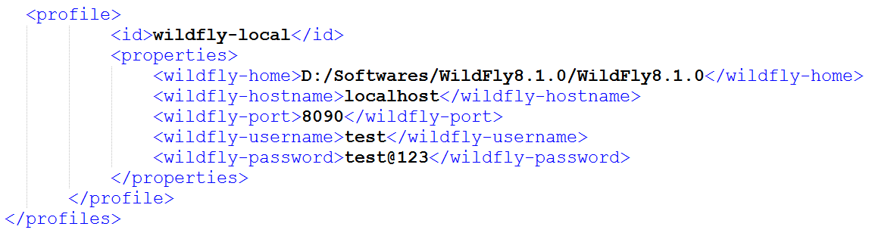
4.4.1 Adding and Updating Dependencies 4.4 Creating Web application using Maven
Add server credentials in settings.xml

Slide 19
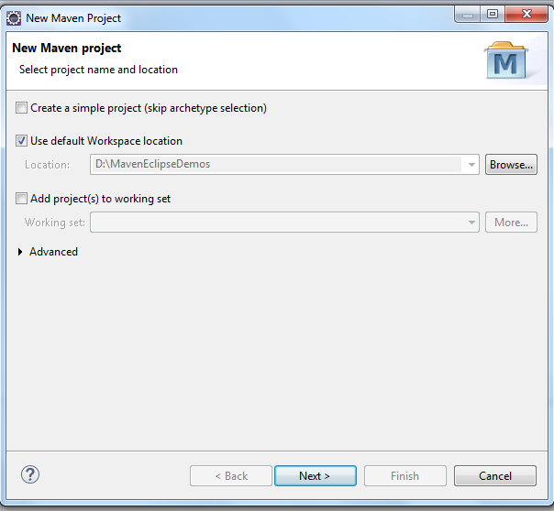
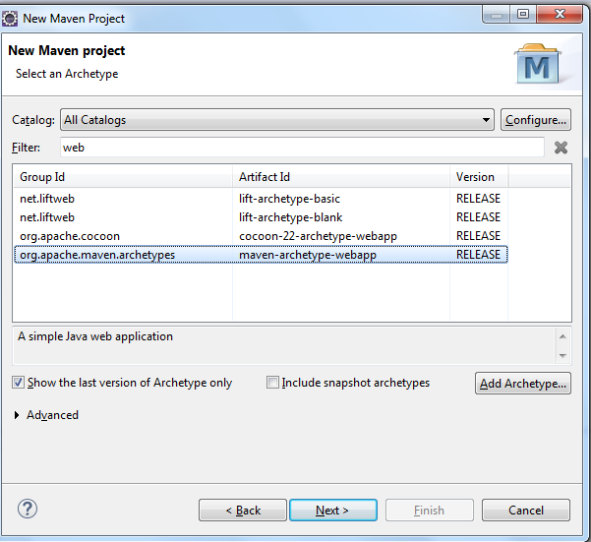
4.4.2 Adding and Updating Dependencies 4.4 Creating Web application using Maven

Slide 20
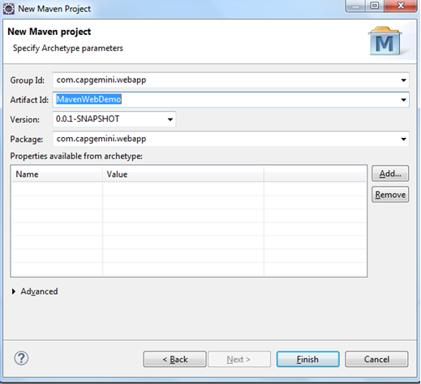
4.4.3 Adding and Updating Dependencies 4.4 Creating Web application using Maven

Slide 21
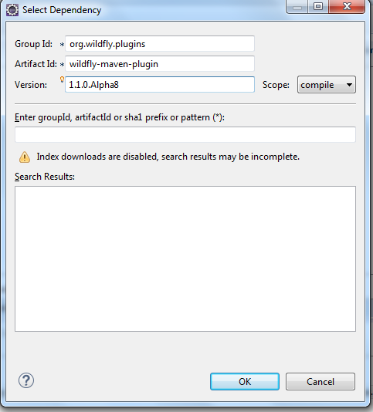
4.4.4 Adding and Updating Dependencies 4.4 Creating Web application using Maven

Slide 22
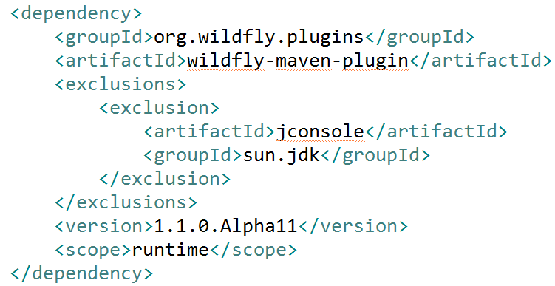
4.4.5 Adding and Updating Dependencies 4.4 Creating Web application using Maven

Slide 23
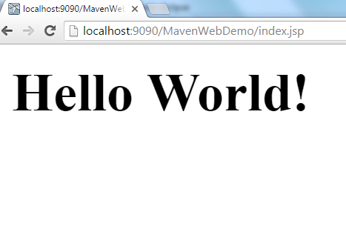
4.4.6 Adding and Updating Dependencies 4.4 Creating Web application using Maven
Type the URL to see the output :
http://localhost:9090/MavenWebDemo/index.jsp

Slide 24
4.4.7 Adding and Updating Dependencies 4.4 Creating Web application using Maven
Creating and executing the “Maven Example!” program
Notes:
Page 04-<number>
Maven Creating Applications with Maven

Slide 25
4.4.8 Integrating Maven with Eclipse
Lab: 2
2.1: Configure environment to run Maven project
2.2: Creating a sample Maven project

Slide 26
Summary
In this lesson, you have learn about:
      Overview
      Testing your application
  Generating Java Projects using Maven
      Using archetype
      Creating Maven Module
  Generating Java web application Projects using Maven
Notes:
Explain the lesson coverage
Page 04-<number>
Maven Creating Applications with Maven

Slide 27
Review Question
Question 1: mvn deploy command executes all the build phases in the default lifecycle
      True
      False
Question 2:Configuration of dependencies, is specified in which of the following files?
      pom.xml
      setting.xml
      .m2 folder
      test files
Notes:
Answers for the Review Questions:
Question 1: True
Question 2: pom.xml
Page 04-<number>
Maven Creating Applications with Maven

Slide 28
Review Question
Question 3: ________________repository for containing released artifacts and _____________ repository for storing deployed snapshots.
Question 4: Which of the following statements is true?
      groupId and artifactId must be same in a project.
      groupId and artifactId may be same in a project.
      groupId and artifactId must not be same in a project.
Notes:
Answers for the Review Questions:
Question 3: Internal and Snapshot
Question 4: groupId and artifactId may be same in a project.
Page 04-<number>
Maven Creating Applications with Maven

